Slide 1

Aviation Risk Assessment for
Strategic Business Expansion
Aviation Expansion: Opportunity or Risk?
The Opportunity: Our company is expanding into commercial and private aviation.
The Challenge: How do we minimize operational and financial risks while entering a highly regulated, safety-critical industry?
Goal: Use historical data to identify the safest aircraft options and flight conditions.

Slide 2

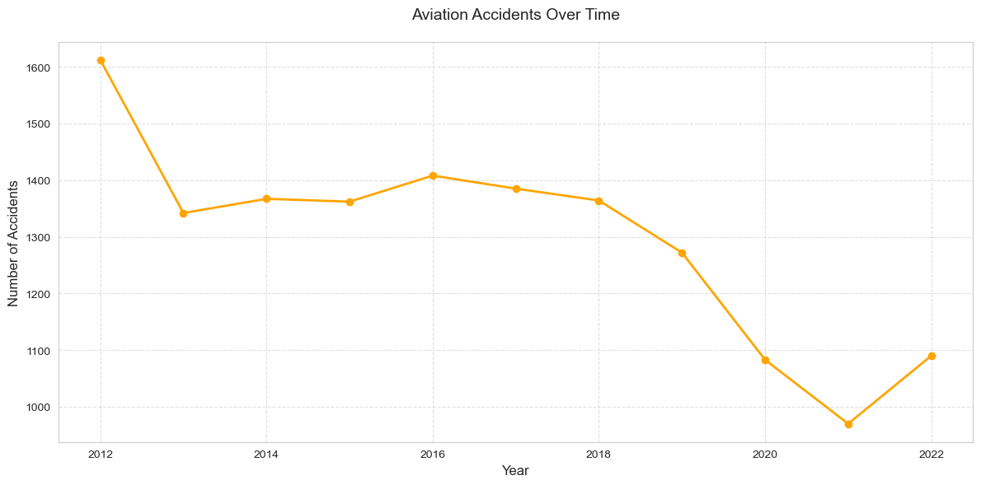
Business Understanding – Why Risk Matters
The aviation industry has high capital investment and operational risk.
Wrong aircraft decisions can lead to high accident exposure, insurance costs, and reputational damage.
Our objective is to choose the lowest-risk aircraft based on evidence.
Besides, number of accidents has been declining but still poses a risk to the industry that needs investigation as it’s evident below.

Slide 3
Data Discovery – Uncovering the Truth
Data Sources:
National Transport Safety Board(NTSB) – the data includes aviation accident data from 1962 to 2023 about civil aviation accidents (via Kaggle).
Focus Years:
2012–2023 which is most relevant to the current trends.
Focus Areas:
Weather Conditions: VMC(Visual Meteorological Condition) and IMC(Instrumental Meteorological Condition).
Aircraft Make: Manufacturer impact
Aircraft category: Airplane VS Helicopters
Operational Context: Flight purpose (commercial, cargo, private)
Metrics to Analyze:
Number of accidents
Fatality rates
Risk percentages by cause
Trend over time

Slide 4
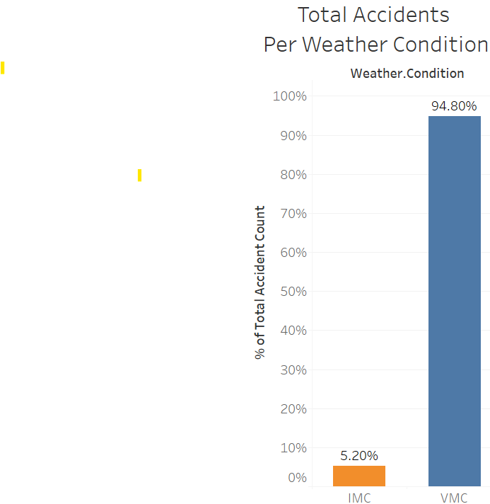
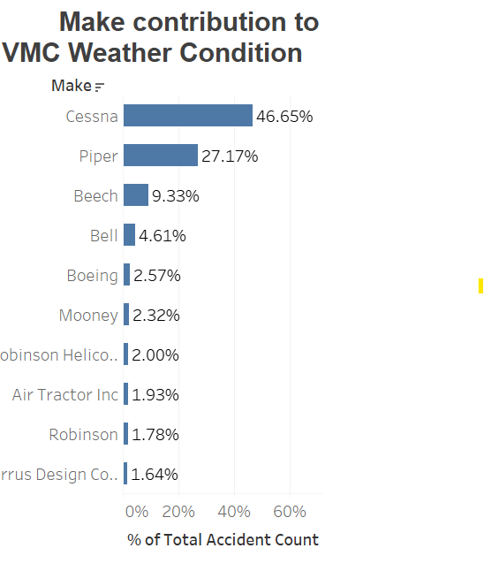
Weather Conditions
VMC contributed 95% of the total accidents with highest fatalities as compared to IMC.
This is not only weather dependent – Cessna and Piper Make contributed 47% and 27% respectively to the total accidents by VMC Weather condition.
While Robinson and Cirrus Designs contributed showed zero contribution.
Cessna and Piper Makes- Considered High risky make in centrally Robinson and Cirrus Designs - Considered lower risky makes.

Slide 5
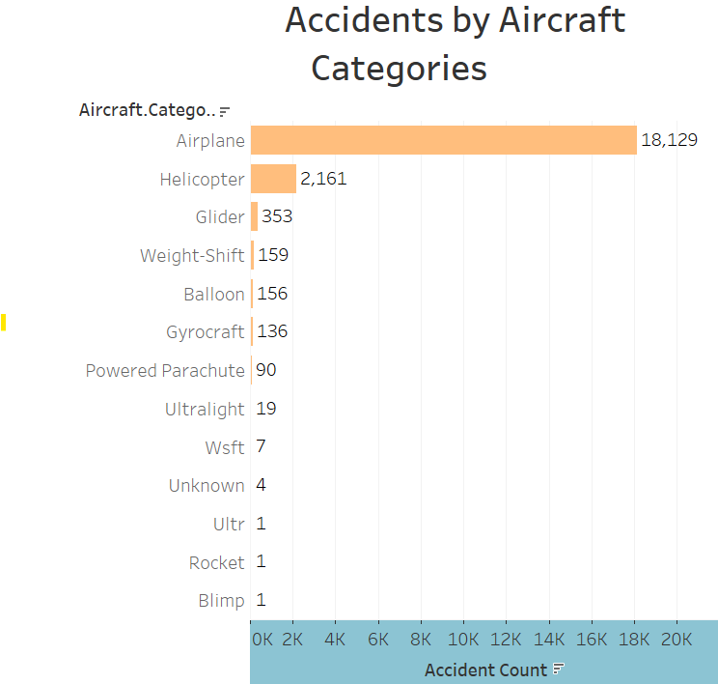
Aircraft category
Airplanes had highest number of accidents thus posed as high risky category as compared to Helicopter.
A new venture into the aviation industry can consider Helicopters to Airplanes.

Slide 6
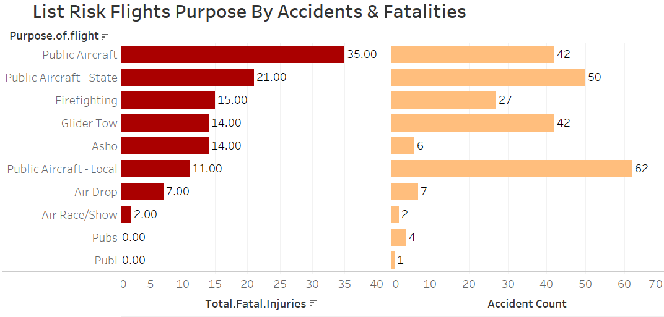
Operational Context: Flight purpose (commercial and private)
. Public Aircrafts posed highest number of accidents and fatalities – High risky category.
.Pubs and Publ Categories are the safest with minimal number of accidents- safest category.

Slide 7
Recommendations – Risk Based Aircraft Acquisition
Aircraft Selection:
Prioritize investing in aircrafts categories with the lowest accidents and fatality rates.
Consider Helicopters to Airplanes
Weather Conditions:
Choose aircraft with strong IMC performance.
Training:
Reinforce pilot preparedness for weather and landing/takeoff risk.
Visual Summary Box:
Recommended Action: Proceed with shortlist evaluation based on risk profile.

Slide 8
THANK YOU
You can reach me through email: erickmauti244@gmail.com

